Slide 1
Enhanced Steganography Tool
CAPSTONE PROJECT
Presented By: Aniket Lamba
Student Name : Aniket Lamba
College Name & Department : Amity Institute of Information Technology, MCA - 2A

Slide 2
OUTLINE
Problem Statement
Technology used
Wow factor
End users
Result
Conclusion
Git-hub Link
Future scope

Slide 3
Problem Statement
Digital communication privacy is increasingly important as cyber threats grow. Traditional encryption methods attract attention, while steganography offers a discreet alternative by hiding messages within ordinary images. This project develops an enhanced steganography tool that securely conceals text messages in images without visible changes, providing an additional layer of privacy for sensitive communications.

Slide 4
Technology used
Python 3.7+: Core programming language
OpenCV (cv2): Image processing library
NumPy: Scientific computing library
Argparse: Command-line interface management
hashlib: SHA-256 cryptographic hashing
LSB Steganography: Least Significant Bit modification technique
XOR Encryption: Bitwise encryption with password-derived key

Slide 5
Wow factors
Visually Undetectable: Encoded images appear identical to originals
Strong Encryption: SHA-256 based password protection with XOR cipher
Header Detection: "STEGO" magic number ensures reliable message identification
Robust Error Handling: Clear feedback for all operations
Cross-Platform Support: Works seamlessly on Windows, macOS, and Linux

Slide 6
End users
Privacy-conscious Individuals: People wanting to communicate secretly
Cybersecurity Students: Learning about data hiding techniques
Digital Forensics Professionals: Understanding steganography detection
Journalists & Activists: Protecting sensitive communications
IT Security Departments: Assessing organizational security vulnerabilities

Slide 7


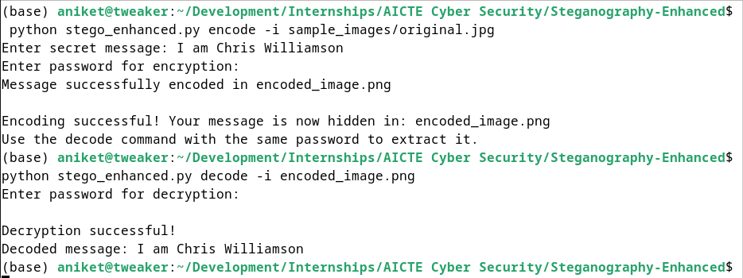
Results
Original
Encoded Image
CLI in action:

Slide 8
Conclusion
The Enhanced Steganography Tool successfully addresses the need for secure covert communication by implementing LSB steganography with robust SHA-256 based encryption. The project demonstrates that visually imperceptible changes to images can effectively hide messages while maintaining security through proper password protection. The tool's implementation of a "STEGO" magic number header ensures reliable message detection and extraction. Comprehensive error handling and cross-platform compatibility make it accessible to users across different operating systems. This implementation provides a practical solution for privacy-conscious users needing to transmit sensitive information covertly while maintaining the integrity of the carrier image.

Slide 9
GitHub Link
https://github.com/mr-tweaker/steganography-enhanced

Slide 10
Future scope(optional)
Advanced cryptographic algorithms integration
Support for hiding various file types (documents, images, audio)
Steganography detection resistance techniques
Integration with other covert channels (network protocols, audio files)
Development of a graphical user interface for non-technical users
Mobile application development for on-the-go steganography
Statistical analysis resistance methods
Distributed steganography across multiple carrier files

Slide 11
THANK YOU

